Slide 1
Preventing outbreaks: West Nile Virus in Chicago, IL
Blaine Murphy
January 2022

Slide 2
The problem
The first positive West Nile Virus (WNV) case in Chicago was in 2002
20% of humans exposed to the virus will experience symptoms
1 / 150 infected will develop serious and sometimes fatal illness
Humans are infected primarily through the bites of virus-carrying mosquitos
Chicago Department of Public Health (CDPH) sought to mitigate risk by installing a system traps
70+ traps placed around the city each summer
Traps are sampled once a week or more, and tested for WNV
Limited pesticide spraying after positive tests
To spray proactively instead of reactively, can we employ machine learning to predict where WNV will occur based on weather data?
Yes, with recall/sensitivity of almost 80%

Slide 3
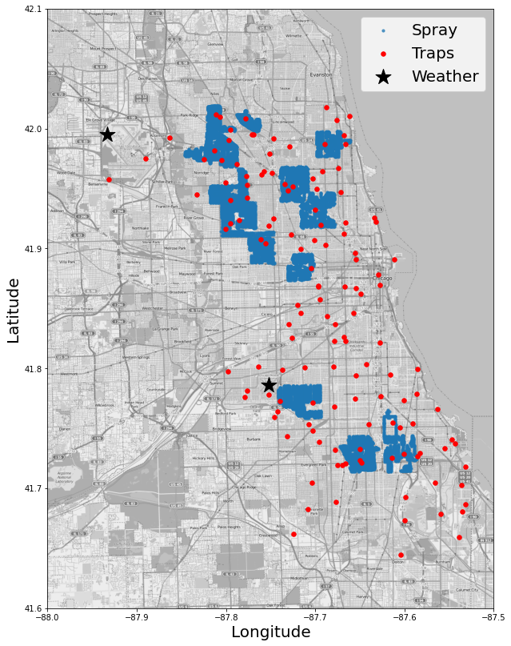
The Data
Traps data (Red)
73-116 traps that are collected (mostly) weekly
Location, number of mosquitos collected, species, and result of WNV test
Weather data (Black)
Data collected daily at stations located at airports ORD & MDW
Includes daily temperatures, precipitation, dew point, air pressure, wind speed and more
Spraying data (Blue)
Records of date, time and location of pesticide spraying

Slide 4
Traps Data Wrangling
Trap Data from 2007 to 2013
Date and location of trap collection
Number of mosquitos and species
WNV result
Target is ‘WnvPresent’
0 = negative, 1 = positive
Need to aggregate records split due to mosquito species and number of specimens
10,506 length data set becomes 4,616 records for training and testing
8% or records are WNV positive
Year | Unique Date/Traps | # of Date/Traps >1 record
2007 | 1,459 | 1,006
2009 | 1,006 | 648
2011 | 988 | 574
2013 | 1,163 | 709

Slide 5
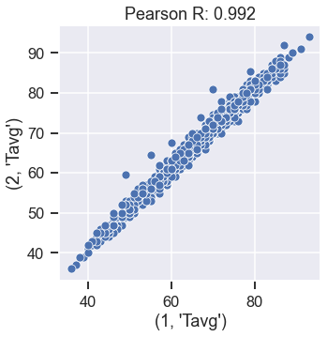
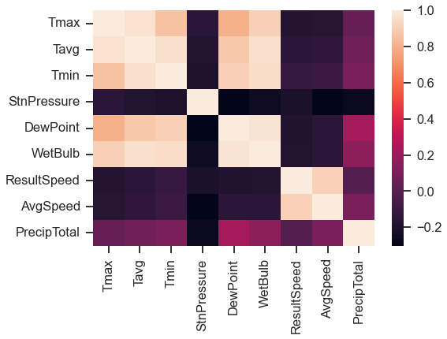
Weather Data Wrangling
Data includes daily measurements from 2 stations
Temperature max, min, average, & departure from norm
Precipitation
Dew point and air pressure
Wind speed and direction
Sunrise and sunset time
Weather codes
Used interpolation to fill a small number of missing temperature values
Temperature Departure wasn’t reported from one station, filled using calculate norm from other station
Some weather features are highly correlated and will need to be dropped
Text column converted to one-hot columns

Slide 6
Weather Integration & Spray Data
Create lag features of weather up to 14 days in the past
Calculate distance between each trap and both weather stations.
For each trap/date, calculate weighted average of weather features from both stations and merge with the trap data
Result is over 300 features in the trap set.
Spray includes Latitude, Longitude and date/time of spraying runs during 2011 & 2013
For the spray data, identified all of the cases where a trap had a positive case and then become negative at next time sample
Most cases were within 5 days of spraying and within 4 miles of a spray.
Created binary feature to indicate whether a spray occurred in the last 5 days within 4 miles and merged with trap set

Slide 7
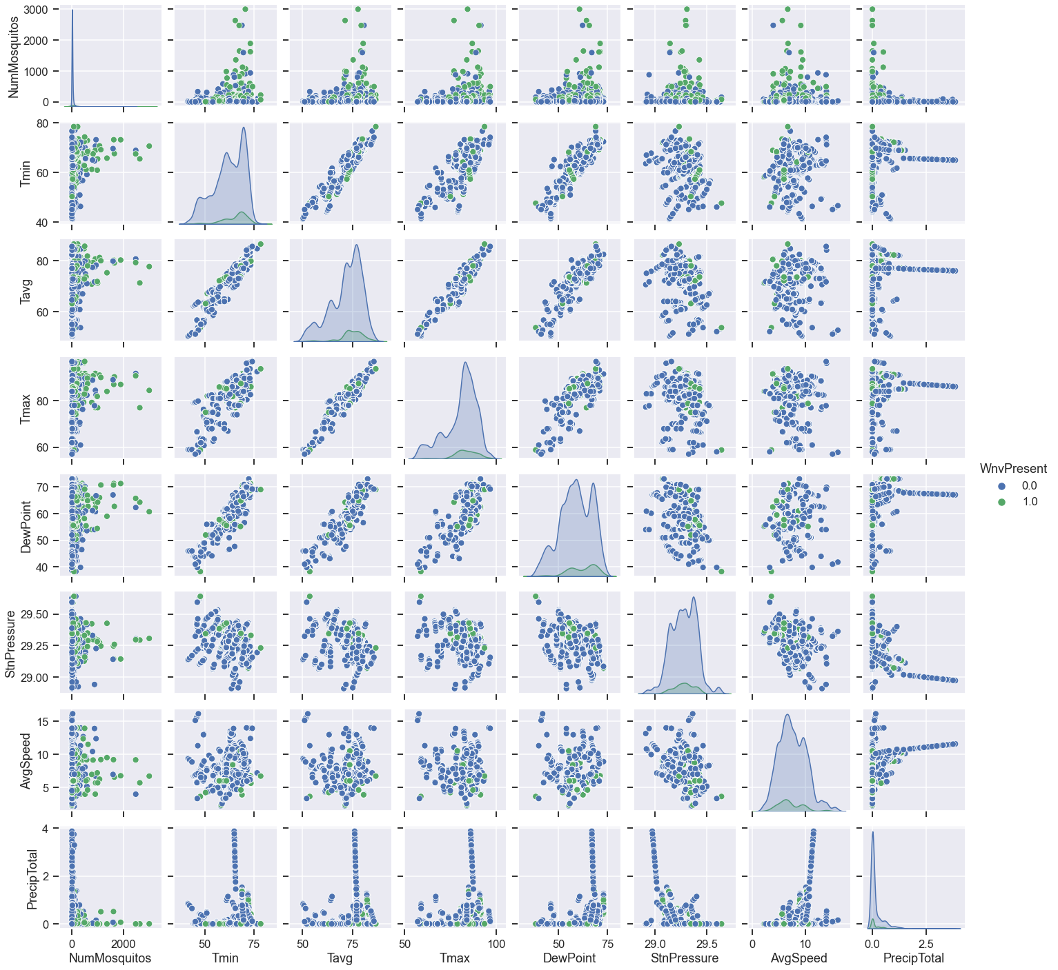
Data Exploration
There are now ~350 columns in the traps data set
A pair plot of trap mosquitos and positivity and the main weather features from the date of trap collection
Shows no obvious relationships to number of mosquitos or positive cases
I believe lag features will be the key for prediction

Slide 8
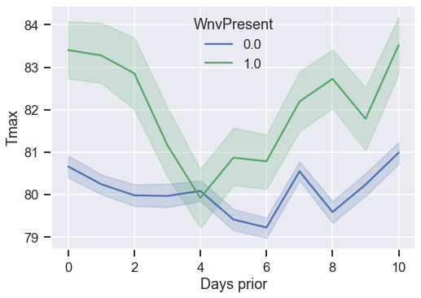
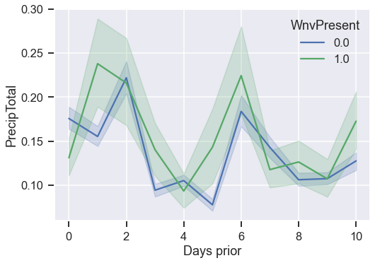
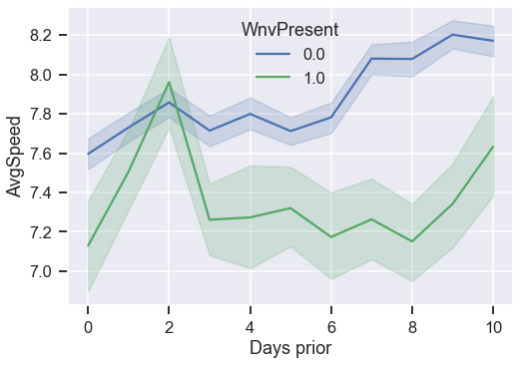
Exploratory Analysis
Looking at the lagged features shows that WNV+ cases tend to follow hot, humid, still days.
Surprisingly there is not a clear separation in the lagged precipitation features

Slide 9
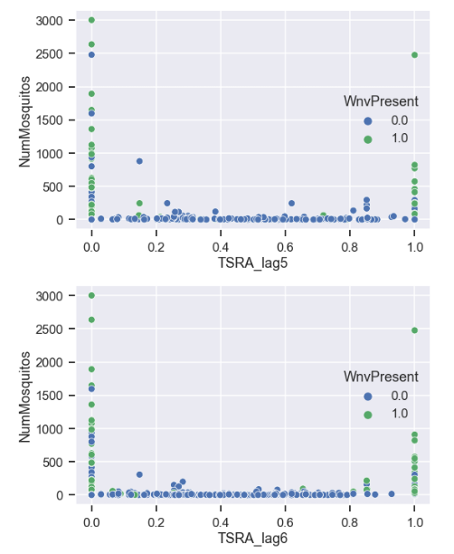
Data Exploration
Lagged Thunderstorm feature
Binary weather columns indicate things like fog, haze, rain, and thunderstorms.
Scatter plots show the lagged values for the thunderstorm category vs the number of mosquitos and colored by WNV+
Positive cases, and large spikes in Mosquitos tend to follow thunderstorm events.
But relationship is non-linear with this feature, so probably need a non-linear model

Slide 10
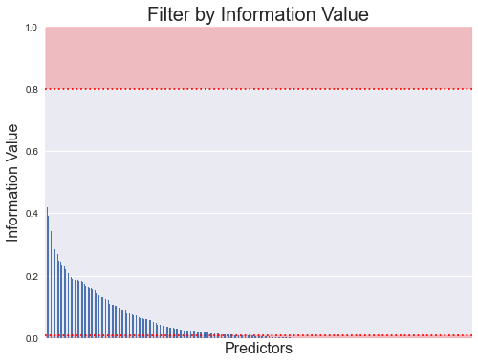
Feature Processing
Data split into 80% training set and 20% testing set (stratified)
Starting with 322 features
Using the training set, calculate the Information Value for each predictor to the target
Drop predictors with IV less than 0.01 or greater than 0.8
Reduced predictors to 142
Applied scaling to all features using only the training set
Iteration: 45

Slide 11
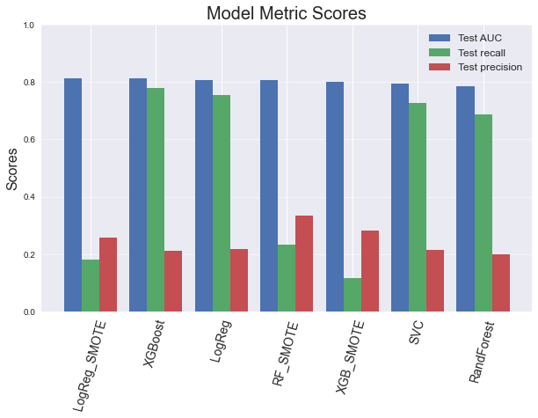
Model Selection
Fit the data on several different models, performing hyperparameter tuning with cross validation
Logistic Regression
Random Forest Classifier
XG Boost Classifier
Support Vector Classifier
Also tried employing SMOTE in a pipeline to find optimal oversampling
Selected XG Boost based on highest AUC score with strong recall.
Prioritize recall for this application to minimize the number of false negatives.

Slide 12
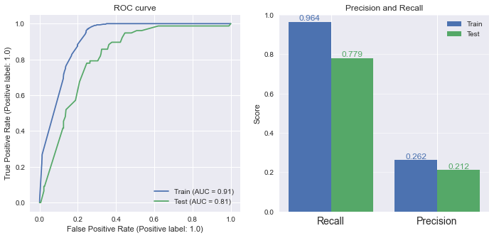
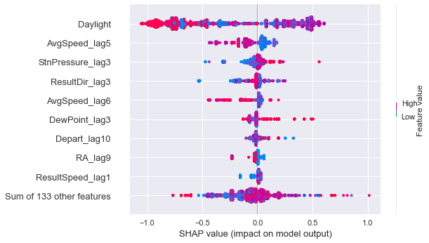
Modelling Performance
Plot below shows the feature importance to the output of the model.
Daylight is the most impactful feature
Other important features include lagged wind speed and direction, air pressure, and dew point
Good performance on hold-out test set with an ROC AUC=81% and recall=77%
There is some indication that the model is overfit
Additional sampling efforts could be made to reduce overfitting and improve performance

Slide 13
Recommendations
The XG Boost model is ready for deployment, and is included in a pipeline that performs all of the preprocessing steps.
Recommend that the model is run on a weekly basis with up to date weather data from the two stations.
Testing indicates there will be a significant number of false positives, and costs are always a limitation
The model can predict probability of a positive case at each location.
Recommend that WNV case probabilities are calculated and spraying is focused on areas of the city with the highest modeled probability for WNV
CDPH can plan council resources to be used for spraying using predictions from the model

Slide 14
Further work
Examination of spatial weather sampling
Model accuracy could decreases as a function of trap distance from the weather station
If so significantly, recommend adding a weather station during the summer months for more dense weather sampling
Mosquito trap sampling
During times of WNV outbreaks/large mosquito populations the traps are sampled more frequently.
Standardize sampling of the traps and see if result is improved.
Maybe add in ‘missing’ trap records and assume negative WNV test to further help train the model
Deep exploration on effect of spray data
Spray effectiveness in both time and space is still not well understood.

